Slide 1
Objective: To assist decision making when modifying a rainwater collection system.
How? Assessing the influence of operational variables in the probability of failure of the system
Failure: Water going out of the system

Slide 2
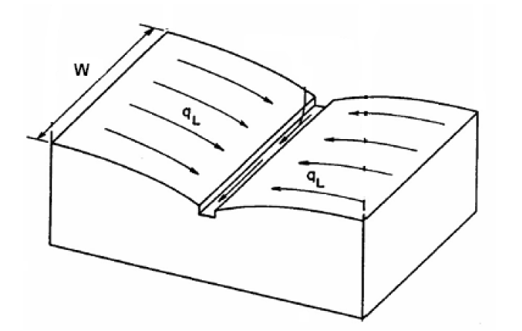
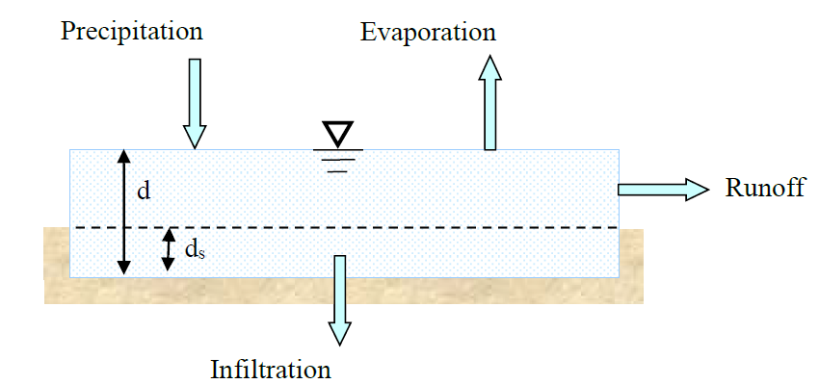
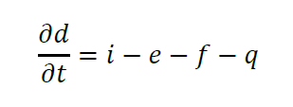
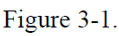
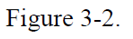
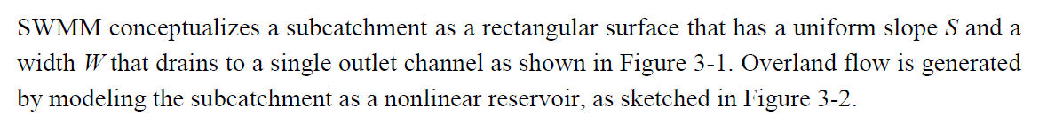
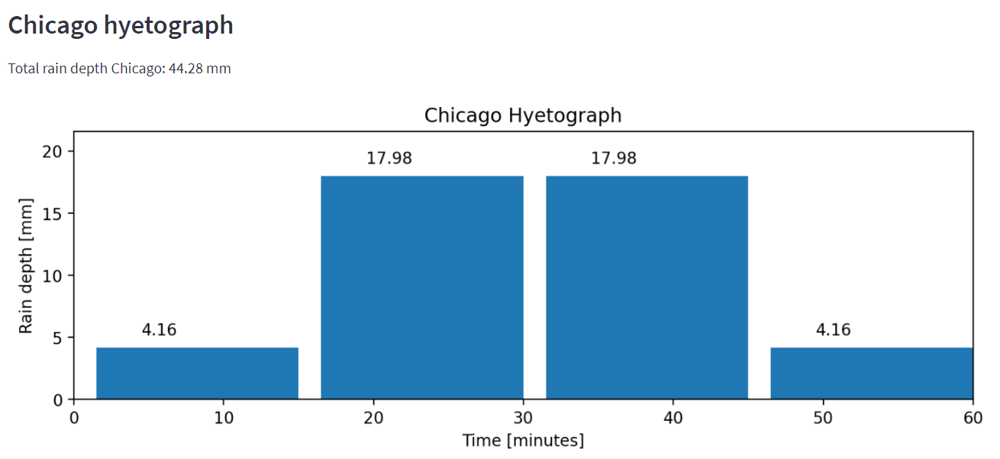
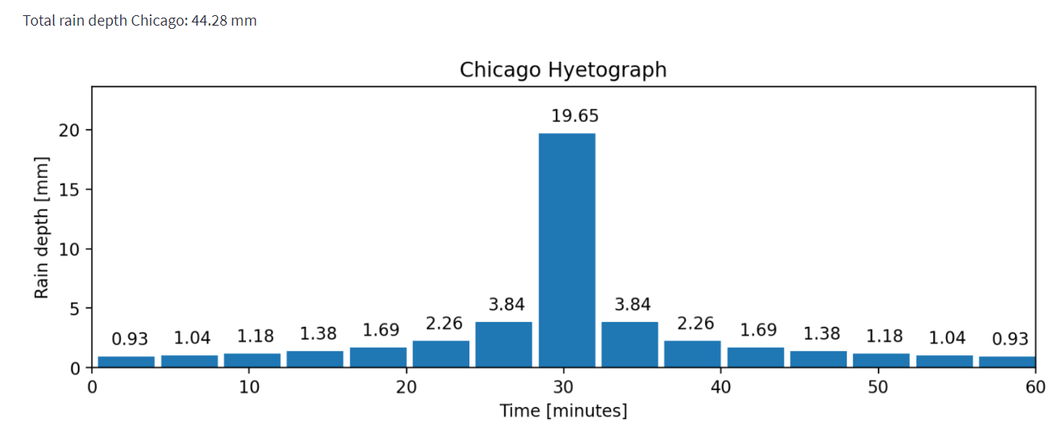
How does SWMM conceptualize the flow of water?
Precipitation = f(LSPP, T, hyetograph model, rain duration, and Δt_{hy})

Slide 3
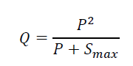
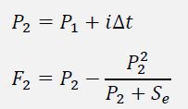
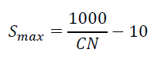
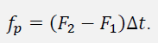
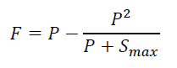
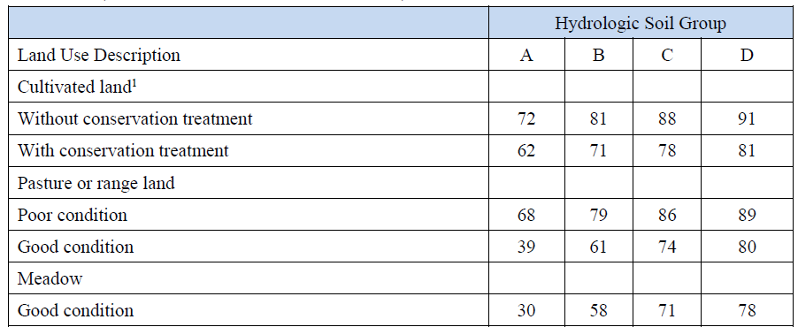
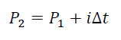
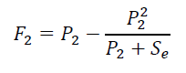
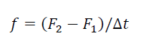
How does SWMM conceptualize the flow of water?
Infiltration = f(CN)
P₁ = 0, F₁ = 0
Compute cumulative rainfall and infiltration at the end of the time step:
Compute potential infiltration rate:
Large CN numbers are associated with less permeable areas

Slide 4
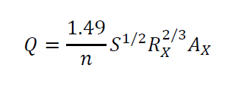
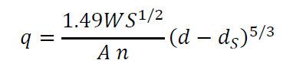
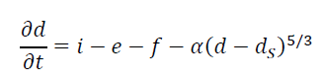
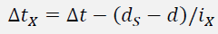
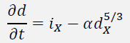
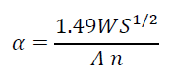
How does SWMM conceptualize the flow of water?
Surface Runoff = f(roughness surface, surface slope, area, width, depression storage)
For each subcatchment, retrieve its current precipitation rate i from the hyetograph.
For each subcatchment:
d_{a} = i*Δt + d
Determine the infiltration rate f using any method.
If f*Δt > d_{a}, then d = 0 and q = 0, otherwise compute rainfall excess i_{x} = i –f.
If i_{x} is not enough to fill d_{s} over the time step, then update d to d + i_{x} Δt and set q=0, otherwise solve mass balance diff. equation.
If at the beginning of the time step d<ds and the rainfall excess is positive, then compute the time step Δt_{x} during which the depth will exceed d_{s} and set d = d_{s}.
Solve: for d over time step Δt_{x}. dx = d-ds.
Compute the runoff per unit area q = αd^5/3 and total runoff Q = q*A
“In general, however, shifting hydrograph peaks in time is difficult to achieve through adjustment of subcatchment flow routing parameters. The time distribution of runoff is by far most sensitive to the time distribution of rainfall.”

Slide 5
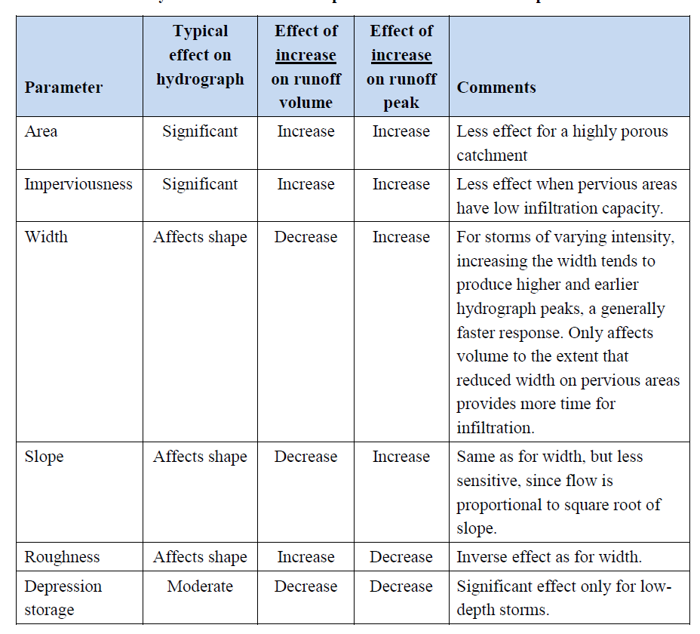

Slide 6
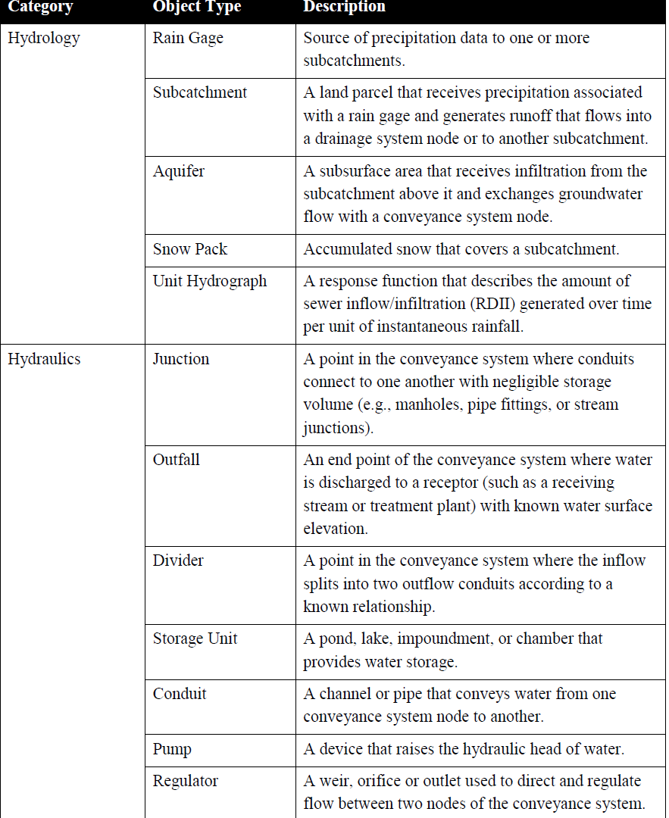
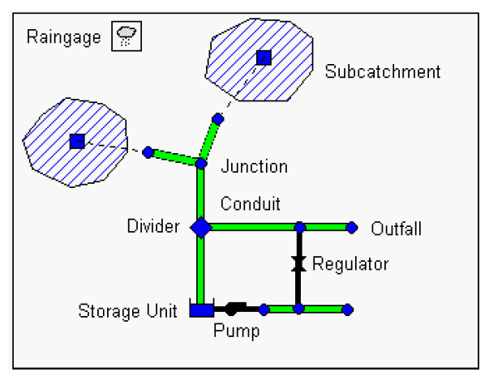
How does SWMM conceptualize the flow of water?

Slide 7
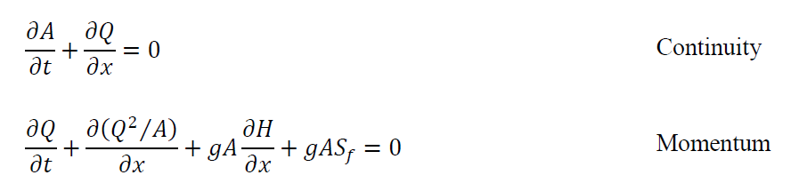
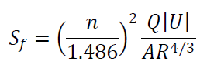
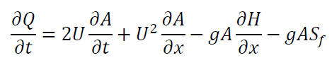
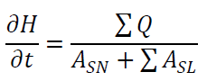
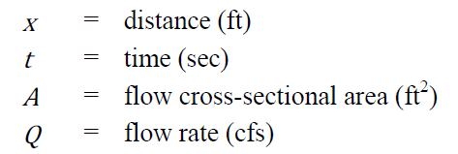
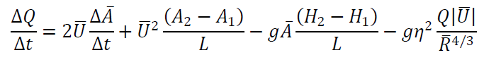
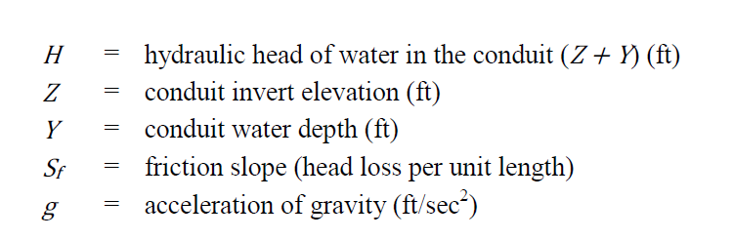
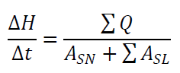
How does SWMM conceptualize the flow of water?
Network flow = f(node elevation, node depth, conduit length, conduit roughness, conduit diameter)
Momentum Equation for conduits
Head variation at nodes
Finite difference approximation of equations

Slide 8
Objective: To assist decision making when modifying a rainwater collection system.
How? Assessing the influence of operational variables in the probability of failure of the system
LSPP - Chicago
CN
Mass balance + Manning
Continuity/Dynamic wave
Precipitation:
LSPP pars
T
Rain duration
Δt_{hy}
r
Infiltration:
CN
Surface Runoff:
Roughness surface
Surface slope
Area SC
Width SC
Depression storage
Network flow:
Node elevation
Node depth
Conduit length
Conduit roughness
Conduit diameter
Fixed quantities: Return period, rain duration, Δt_{hy}, r, surface slope, area SC, width SC, depression storage, node elevation, node depth, conduit lenght
Stochastic quantities: LSPP parameters, roughness surface
Operational quantities: CN, conduit roughness, conduit diameter
Identify areas that can be interesting for the study

Slide 9
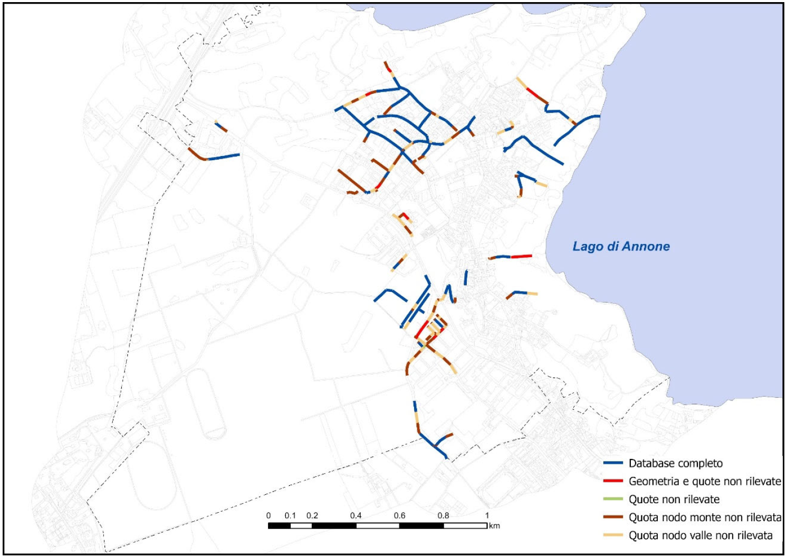
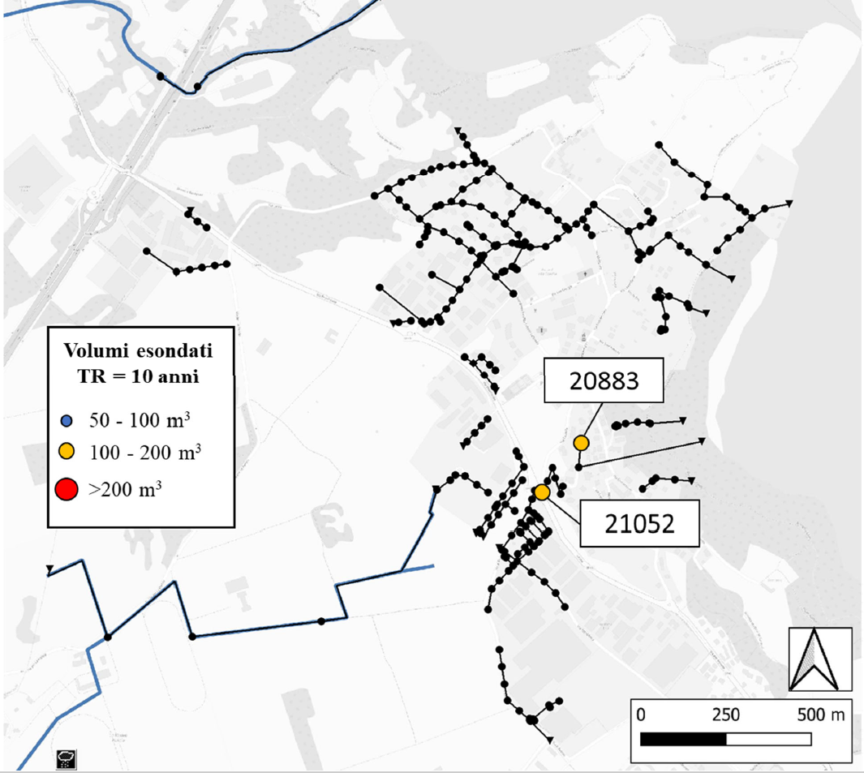

Slide 10
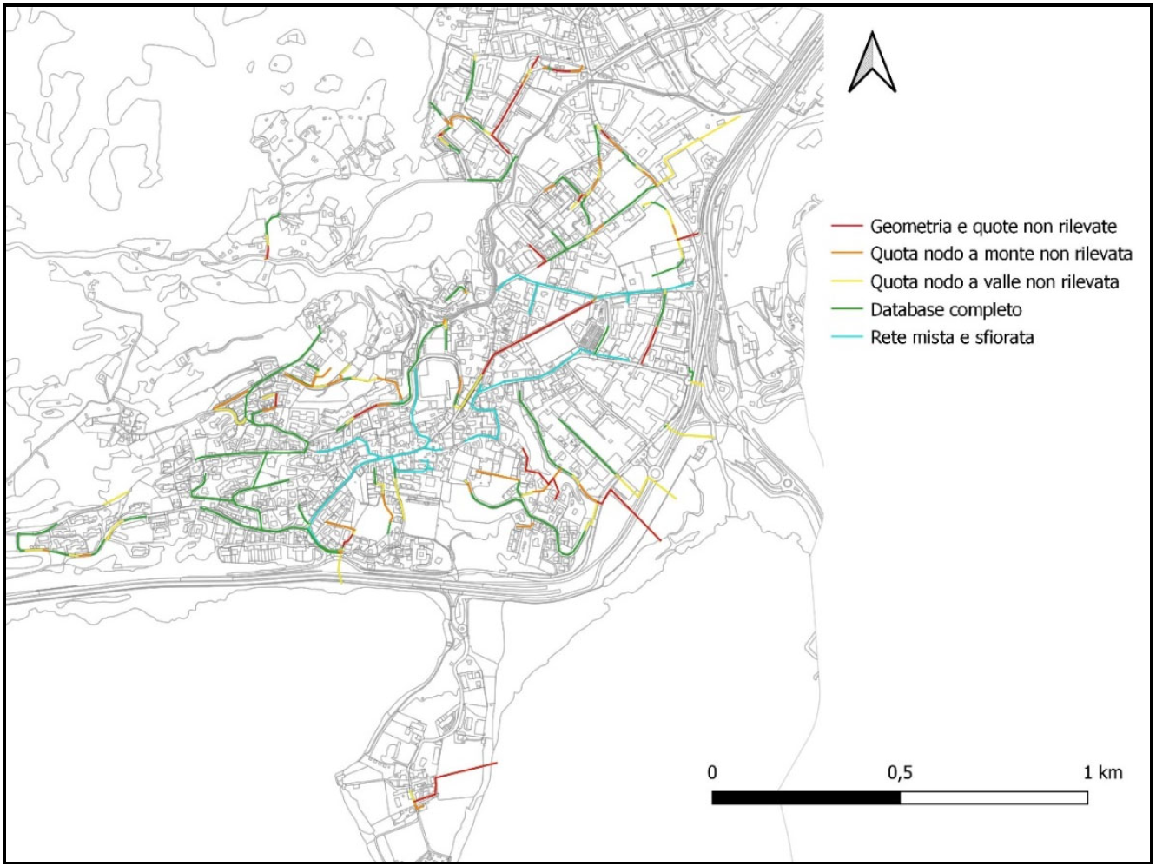
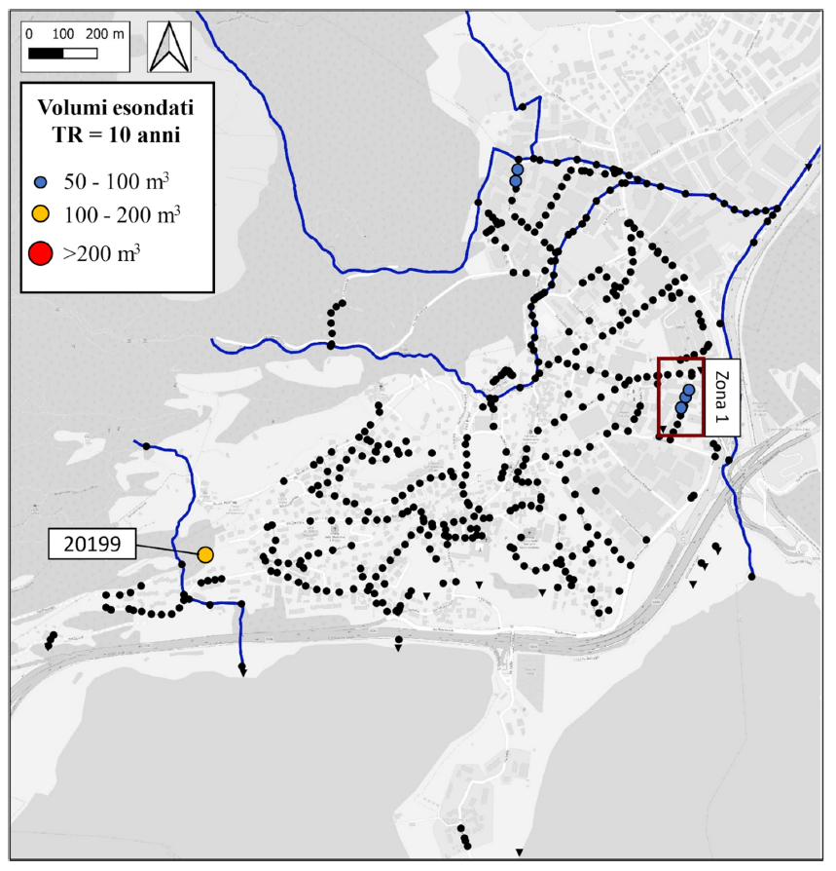

Slide 11
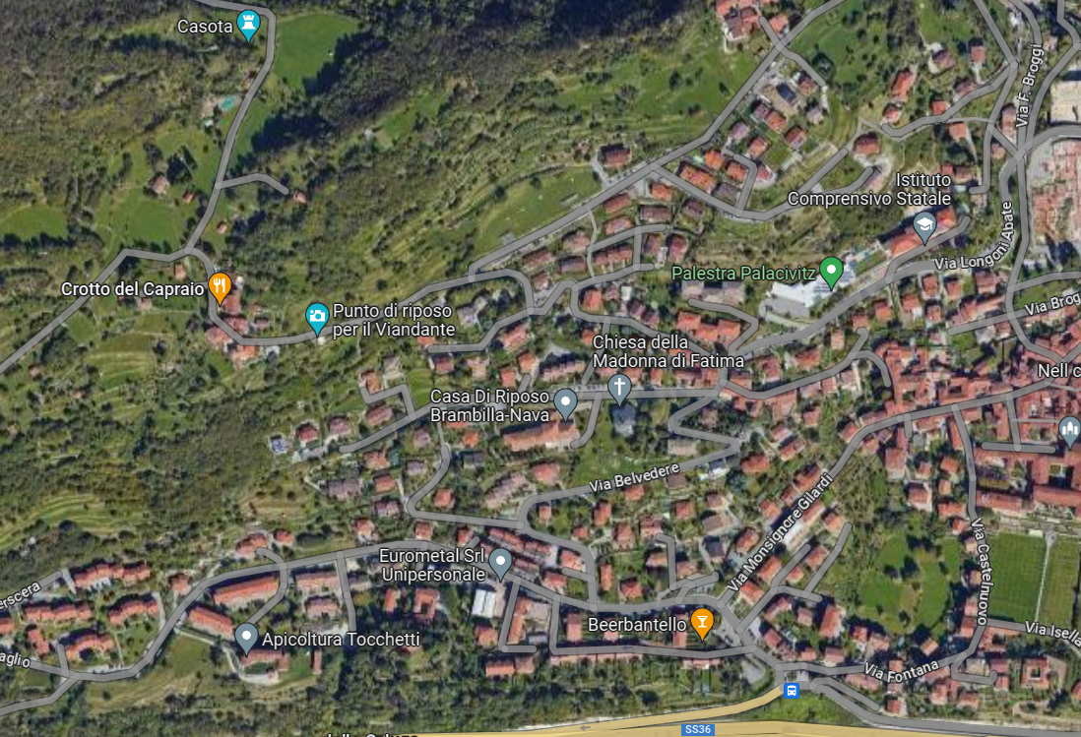

Slide 12
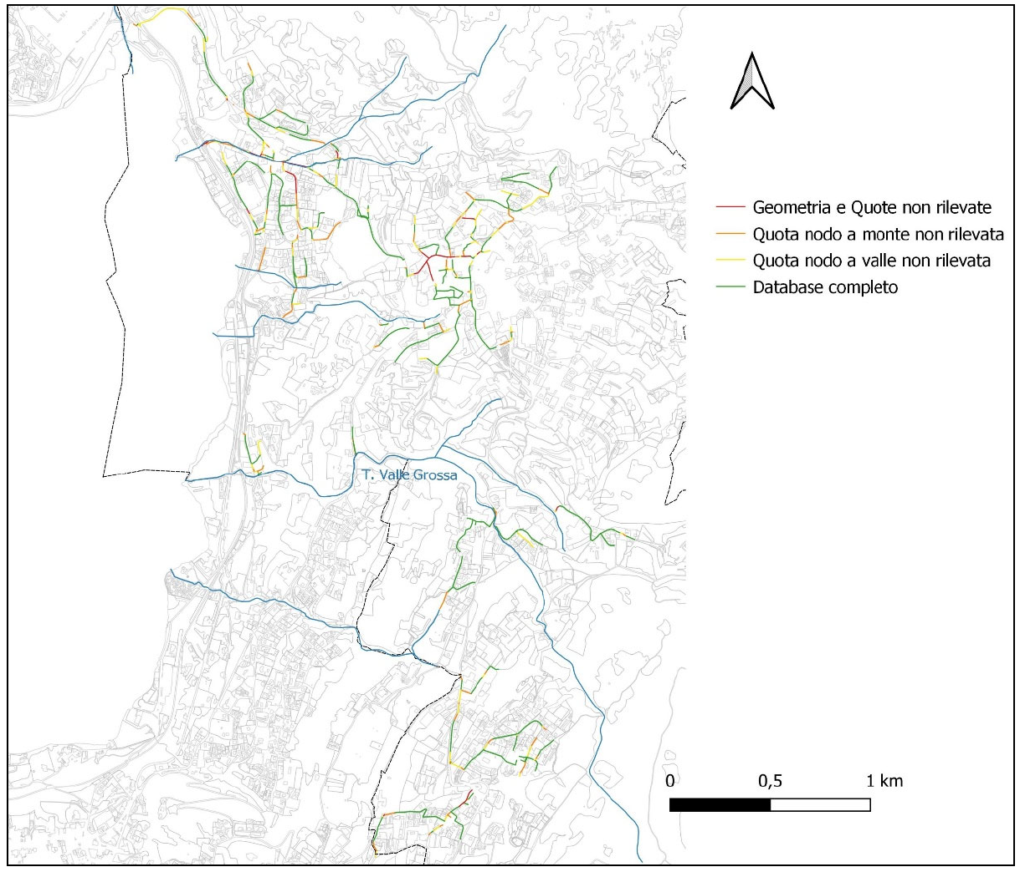
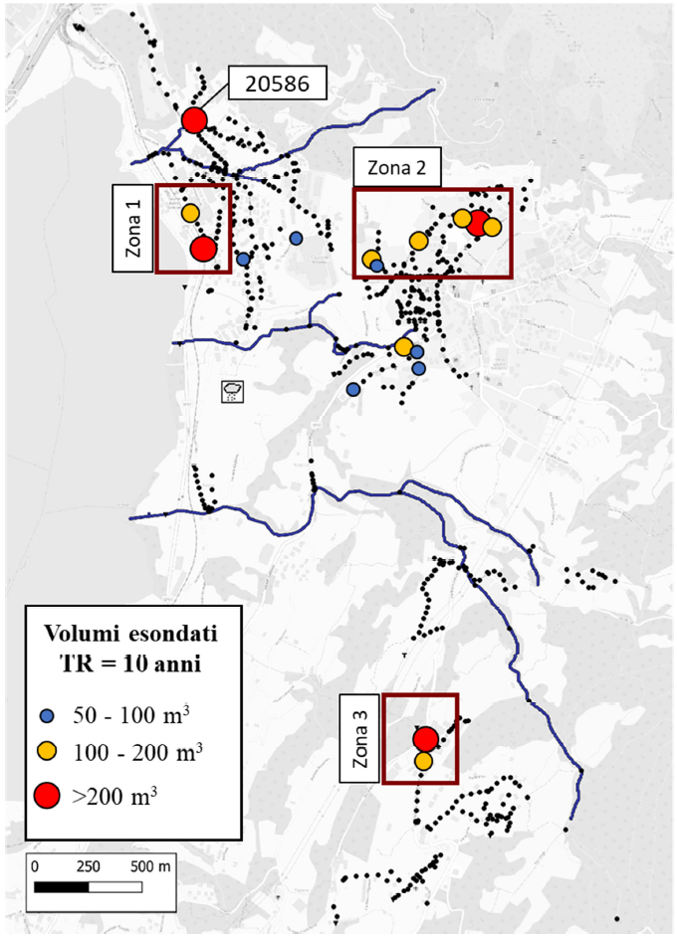

Slide 13
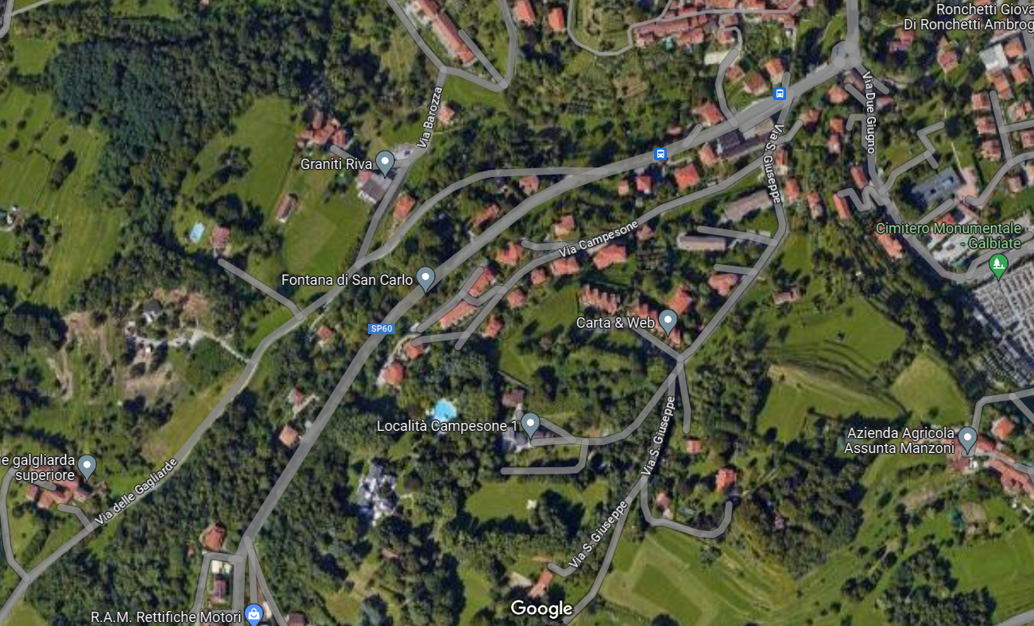
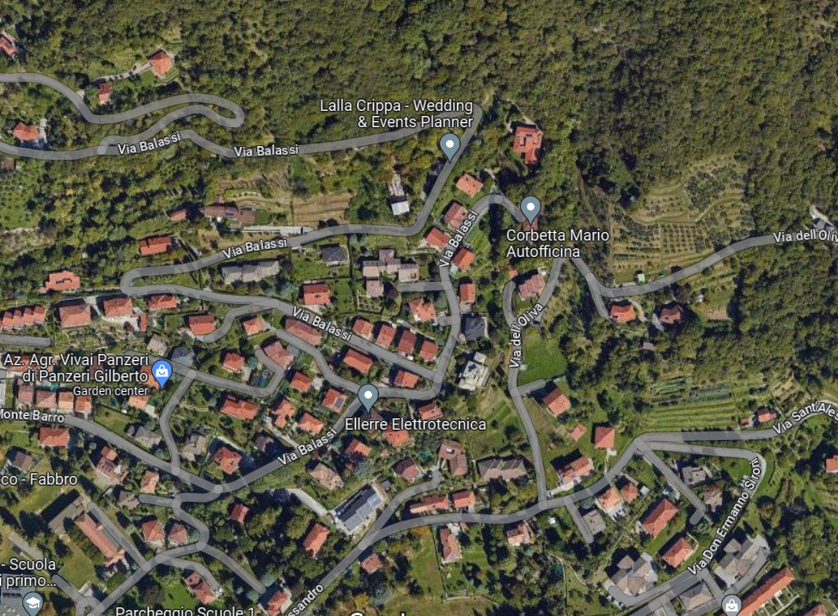

Slide 14
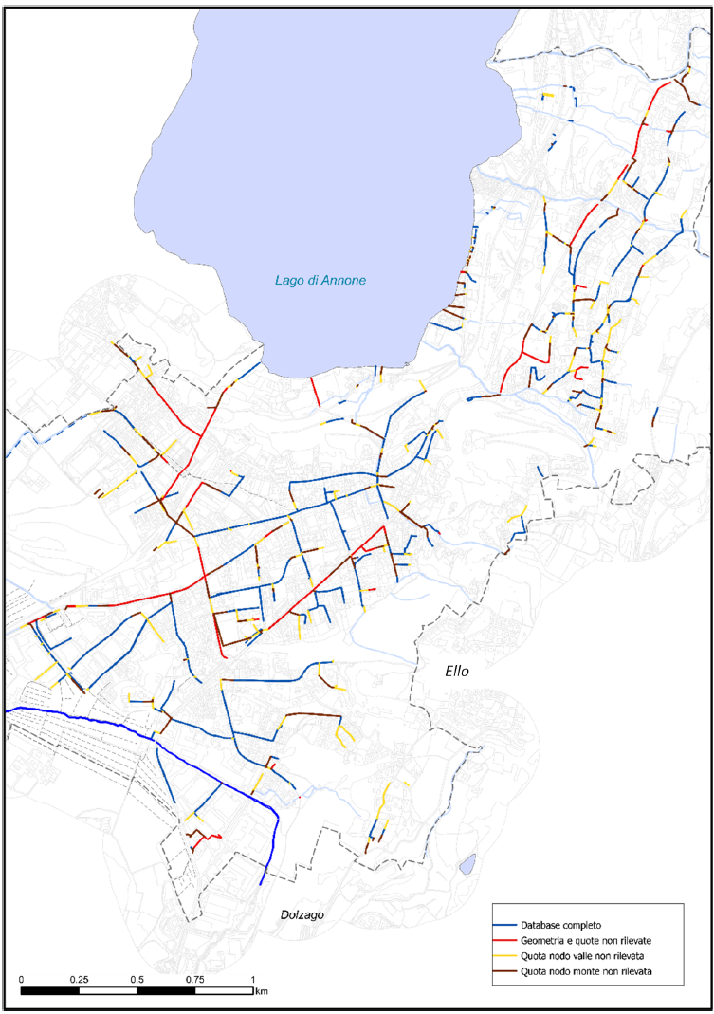
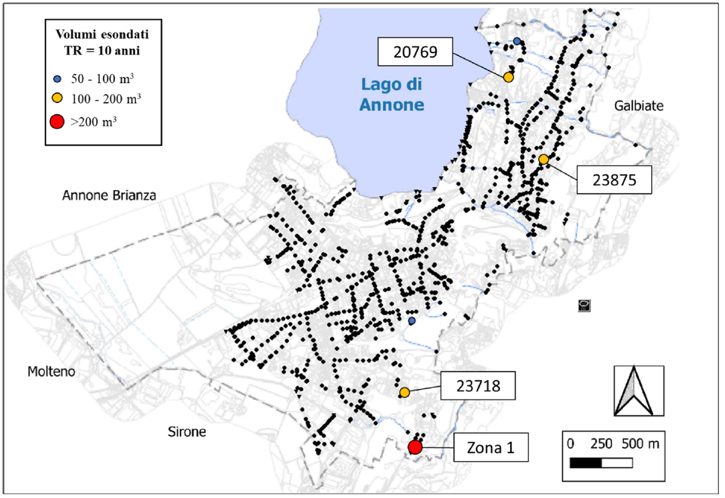

Slide 15
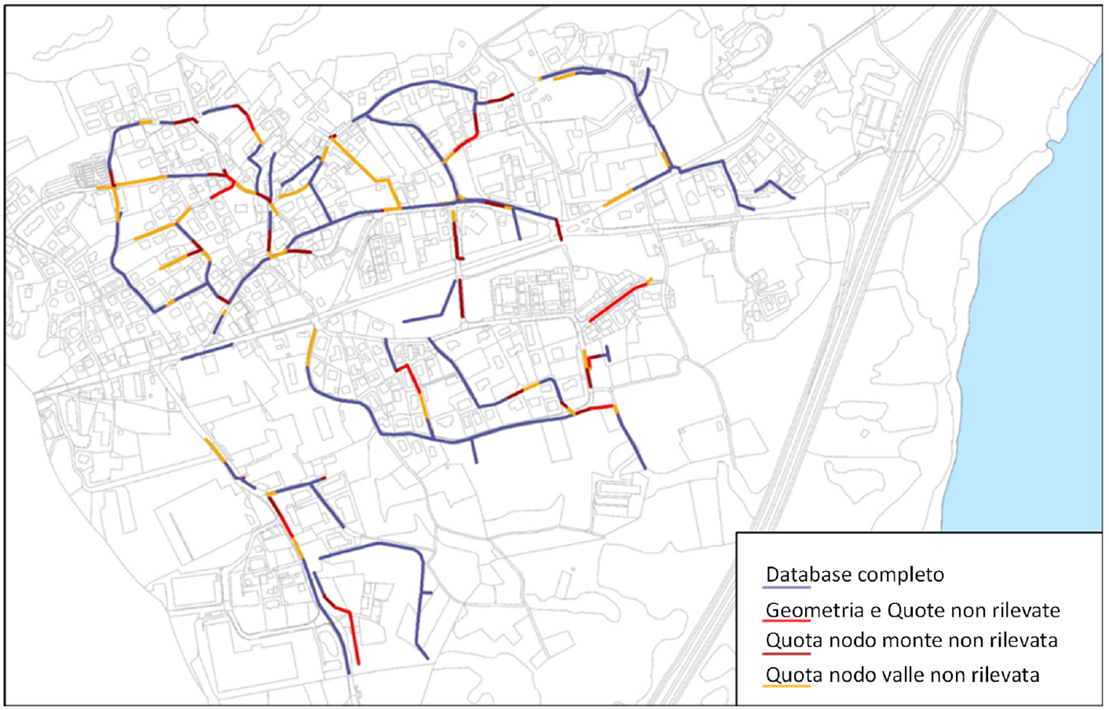
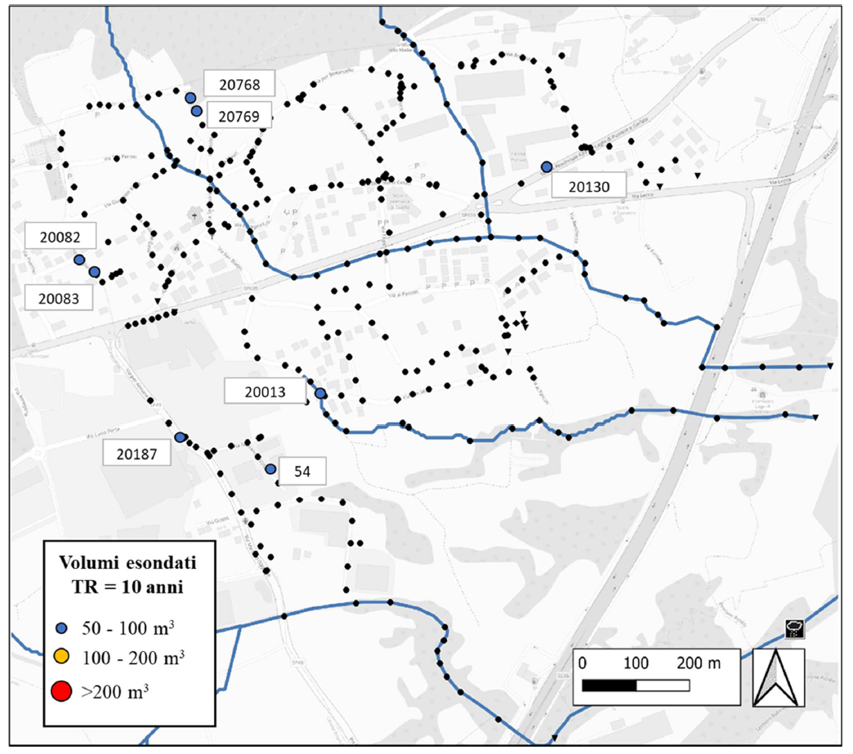

Slide 16
Define ranges of variability
Generate parameter combinations
Run model

